Slide 1

Database Management System

Slide 2
Table of Contents
Introduction to Database
Types of Data models
Database Operations
Advantages of DBMS
Introduction to Relational Database Management System
Features of RDBMS
RDBMS VS Traditional approach
Introduction to Normalization
Need For Normalization
Functional Dependency
Functional Dependency Types
Normalization:
- 1ST Normal Formal
- 2ND Normal Formal
- 3RD Normal Formal
Advantages And Disadvantages of Normalization

Slide 3
Introduction to Database

Slide 4
What is Database?
Database is a collection of information organized for easy access, management and maintenance.
Examples:
Telephone directory
Customer data
Product inventory
Visitors’ register
Weather records

Slide 5
Types of Data Models
Record based logical model
Hierarchical data model
Network data model
Relational data model
Object based logical model
Entity relationship model

Slide 6
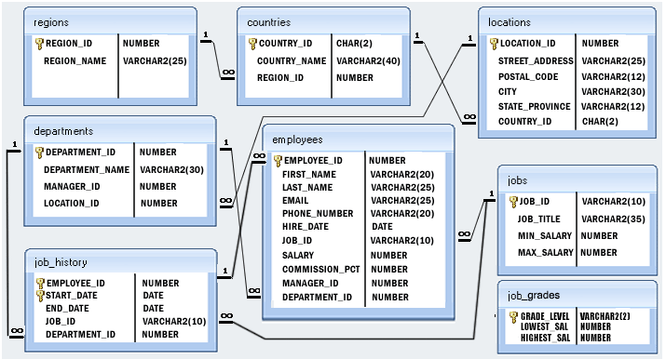
E/R Diagram

Slide 7
DBMS Operations
Adding new files
Inserting data
Retrieving data
Modifying data
Removing data
Removing files

Slide 8
Advantages of DBMS
Sharing of data across applications
Reduced data redundancy
Enhanced security mechanism
Data independence
Better flexibility
Enforce integrity constraints
Better transaction support
Enforce standards
Backup and recovery features

Slide 9
Introduction to RDBMS
A relational database refers to a database that stores data in a structured format, using rows and columns.
This makes it easier to locate and access specific values within the database.
It is "relational" because the values within each table are related to each other.
Tables may also be related to other tables.
The relational structure makes it possible to run queries across multiple tables at once.

Slide 10
Features of RDBMS
Every piece of information is stored in the form of tables
Has primary keys for unique identification of rows
Has foreign keys to ensure data integrity
Provides SQL for data access
Uses indexes for faster data retrieval
Gives access privileges to ensure data security

Slide 11
RDBMS VS TRADITIONAL APPROACH
The key difference is that RDBMS (relational database management system) applications store data in a tabular form, whereas in tradition approach, applications store data as files.
There can be, but there will be no “relation” between the tables, like in a RDBMS. In traditional approach, data is generally stored in either a hierarchical form or a navigational form. This means that a single data unit will have one parent node and zero, one or more children nodes.

Slide 12
Normalization

Slide 13
Normalization
Decompose larger, complex table into simpler and smaller ones
Moves from lower normal forms to higher normal forms.

Slide 14
Normalization and Normal Forms
Normal Forms
First Normal Form (1NF)
Second Normal Form (2NF)
Third Normal Form (3 NF)
Higher Normal Form (BCNF, 4NF, 5NF, …)

Slide 15
Need for Normalization
In order to produce good database design
To ensure all database operations to be efficiently performed
Avoid any expensive DBMS operations
Avoid unnecessary replication of information

Slide 16
Need for Normalization
RAW DATABASE
Student_Details | Course_details | Pre-requisite | Result_details
0101 Tim 11/4/1985 | M1 Advance maths 7 | Basic Math | 02/11/2015 82 A
0102 Rob 10/04/1986 | P4 Advance Physics 8 | Basic Physics | 21/11/2015 89 A
0103 Mary 11/07/1985 | B3 Advance Biology 10 | Basic Biology | 12/11/2015 62 B
0104 Rob 10/04/1986 | H6 Advance History 9 | Basic History | 21/11/2015 89 A
0105 Tom 03/08/1988 | C3 Advance Chemistry 11 | Basic Biology | 12/11/2015 50 C

Slide 17
Functional Dependency
Consider the relation
Result (Student#, Course#, CourseName#, Marks#, Grade#)
Student# and course# together defines exactly one value of marks. Student#, course# ,Marks
Student# and course# determines Marks or Marks is functionally dependent on student# and course#
Other functional dependencies in the relation:
Course# - CourseName
Marks# - Grade

Slide 18
Functional Dependency
In a given relation R, X and Y are attributes. Attribute Y is functionally dependent on attribute X if each value of X determines exactly one value of Y.
X
Y

Slide 19
Functional Dependency Types
Partial Functional Dependency
Transitive Dependency

Slide 20
Functional Dependency Types
Partial Functional Dependency
Attribute Y is partially dependent on attribute X, if and only if it is dependent on the subset of attribute X.
REPORT (Student#, Course#, StudentName, CourseName, Marks, Grade)
Student#, Course#
Mark
Course#
CourseName

Slide 21
Functional Dependency Types
Transitive Dependency
X, Y, Z are three attributes
X
Y
Y
Z
X
Z
Student#
Course#
Marks#
Grade#

Slide 22
Normalization
Second Normal Form (2NF)
First Normal Form
(1NF)
Types of Normal Form
Third Normal Form (3NF)

Slide 23

First Normal Form – (1NF)
Second Normal Form (2NF)
First Normal Form
(1NF)
Types of Normal Form
Third Normal Form (3NF)
A relation schema is in 1NF, if and only if:
All attributes in the relation are atomic in nature and there are no repeating elements or group of elements.

Slide 24
First Normal Form – (1NF)
Student Marks Table
Student_Details | Course_details | Pre-requisite | Result_details
0101 Tim 11/4/1985 | M1 Advance maths 7 | Basic Math | 02/11/2015 82 A
0102 Rob 10/04/1986 | P4 Advance Physics 8 | Basic Physics | 21/11/2015 89 A
0103 Mary 11/07/1985 | B3 Advance Biology 10 | Basic Biology | 12/11/2015 62 B
0104 Rob 10/04/1986 | H6 Advance History 9 | Basic History | 21/11/2015 89 A
0105 Tom 03/08/1988 | C3 Advance Chemistry 11 | Basic Biology | 12/11/2015 50 C

Slide 25
First Normal Form - (1NF)
Student Marks Table in 1NF
Student# | Student_Name | Date Of Birth | Course# | CourseName | Pre- Requisite | Duration in days | Date Of Exam | Marks | Grade
0101 | Tim | 11/4/1985 | M1 | Advance Math | Basic Math | 7 | 02/11/2015 | 82 | A
0102 | Rob | 10/04/1986 | P4 | Advance Physics | Basic Physics | 8 | 21/11/2015 | 89 | A
0103 | Mary | 11/07/1985 | B3 | Advance Biology | Basic Biology | 10 | 12/11/2015 | 62 | B
… | … | … | … | … | … | … | … | … | …

Slide 26
Second Normal Form – (2NF)
Second Normal Form (2NF)
First Normal Form
(1NF)
Types of Normal Form
Third Normal Form (3NF)
A relation is said to be in 2NF, if and only if:
It is in 1NF.
No partial dependency exists between non-key attributes and key attributes.

Slide 27
Second Normal Form – (2NF)
Student Marks Table in1NF
Student# | Student_Name | DOB | Course# | CourseName | Pre Requisite | Duration in days | Date of Exam | Marks | Grade
0101 | Tim | 11/4/1985 | M1 | Advance Math | Basic Math | 7 | 02/11/2015 | 82 | A
0102 | Rob | 10/04/1986 | P4 | Advance Physics | Basic Physics | 8 | 21/11/2015 | 89 | A
0103 | Mary | 11/07/1985 | B3 | Advance Biology | Basic Biology | 10 | 12/11/2015 | 62 | B

Slide 28
Second Normal Form – (2NF)
Student# ,Course# → Marks
Student#, Course# → Grade
Marks → Grade
Student# → StudentName, DOB
Course# → CourseName, Pre-Requisite,
DurationDays, Date of exam
Partial Dependency with the Key attribute
Split/Decompose the tables to remove partial dependencies

Slide 29
Second Normal Form – (2NF)
Student Table
Result Table
Student# | Student_Name | Date Of Birth
0101 | Tim | 11/4/1985
0102 | Rob | 10/04/1986
0103 | Mary | 11/07/1985
Student# | Course# | Marks | Grade
0101 | M1 | 82 | A
0102 | P4 | 89 | A
0103 | B3 | 62 | B
Course Table
Course# | CourseName | Prerequisite | Durationindays | Date Of Exam
M1 | Advance Math | Basic Math | 7 | 02/11/2015
P4 | Advance Physics | Basic Physics | 8 | 21/11/2015
B3 | Advance Biology | Basic Biology | 10 | 12/11/2015

Slide 30
Third Normal Form – (3NF)
Second Normal Form (2NF)
First Normal Form
(1NF)
Types of Normal Form
Third Normal Form (3NF)
A relation R is said to be in 3NF if and only if:
It is in 2NF.
No transitive dependency exists between non-key attributes and key attributes through another non-key attribute.

Slide 31
Third Normalization – (3NF)
Result_table
Student# | Course# | Marks | Grade
0101 | M1 | 82 | A
0102 | P4 | 89 | A
0103 | B3 | 62 | B
Student# ,Course# → Marks
Student#, Course# → Grade
Marks → Grade
Student#,Course#→ Marks→ Grade:TD
Remove

Slide 32
Third Normalization – (3NF)
Result Table
Marks Grade Table
Student# | Course# | Marks
0101 | M1 | 82
0102 | P4 | 89
0103 | B3 | 62
Marks | Grade
82 | A
89 | A
62 | B

Slide 33
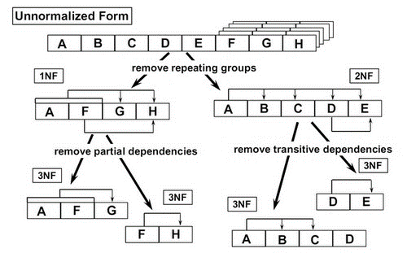
Normalization In Nutshell

Slide 34
Advantages And Disadvantages Of Normalization
ADVANTAGES | DISADVANTAGE
Based on mathematical foundation Removes the redundancy to a large extent After 3NF, data redundancy is minimized to the extent of foreign keys Removes the anomalies present in INSERTs, UPDATEs and DELETEs | Data retrieval or SELECT operation performance will be severely affected Normalization might not always represent real world scenarios

Slide 35
THANK YOU

